Slide 1
Capstone Project-2 Yes Bank Stock Closing Price Prediction BY ADITYA .S.REKHATE DATA SCIENCE TRAINEE AT ALMABETTER

Slide 2
Linear regression is a statistical method used to analyze and model the relationship between two or more variables. It is called linear because it assumes that there is a linear relationship between the independent variable(s) and the dependent variable. The goal of linear regression is to find the best fit line that summarizes the relationship between the variables. In multiple linear regression, there are multiple independent variables and one dependent variable, and the relationship between them is modeled using a linear equation with multiple variable y = b0 + b1x1 + b2x2 + ... + bn*xn where y is the dependent variable, x1, x2, ..., xn are the independent variables, and b0, b1, b2, ..., bn are the coefficients (or slopes) of the independent variables.
Linear Regression

Slide 3
Linear Regression Assumption
Linearity: The relationship between the dependent variable and the independent variables is linear.
Independence: The observations in the dataset are independent of each other.
Homoscedasticity: The variance of the errors is constant across all values of the independent variables.
Normality: The errors are normally distributed.
No multicollinearity: The independent variables are not highly correlated with each other.
No influential outliers: The dataset does not contain any extreme observations that significantly affect the regression model.

Slide 4
Problem Statement
Yes Bank is a well-known bank in the Indian financial domain. Since 2018, it has been in the news because of the fraud case involving Rana Kapoor. Owing to this fact, it was interesting to see how that impacted the stock prices of the company and whether Time series models or any other predictive models can do justice to such situations. This dataset has monthly stock prices of the bank since its inception and includes closing, starting, highest, and lowest stock prices of every month.

Slide 5
Regularazation 1.Lasso Lasso regression, also known as L1 regularization, is a linear regression technique that adds a penalty term to the loss function of the model, which is proportional to the absolute values of the model coefficients. This penalty term helps to constrain the model coefficients to be small, which can lead to a simpler and more interpretable model.

Slide 6
Ridge regression, also known as L2 regularization, is a linear regression technique that adds a penalty term to the loss function of the model, which is proportional to the square of the model coefficients. This penalty term helps to constrain the model coefficients to be small, which can lead to a simpler and more stable model.
2.Ridge

Slide 7
Elastic Net is a type of regularization method used in linear regression and other statistical models. It combines the penalties of the L1 (Lasso) and L2 (Ridge) regularization methods.In traditional linear regression, the objective is to minimize the sum of squared errors between the predicted values and the actual values. However, this can lead to overfitting of the model, where it performs well on the training data but poorly on new, unseen data.
Elastic Net

Slide 8
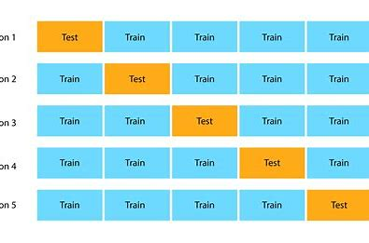
Cross-validation is a technique used in machine learning to assess the performance of a predictive model. The basic idea behind cross-validation is to divide the available data into multiple subsets, called folds, and then use each fold in turn to evaluate the model trained on the remaining data.The most common form of cross-validation is k-fold cross-validation. In k-fold cross-validation, the data is divided into k subsets of roughly equal size. The model is trained on k-1 of these subsets and then evaluated on the remaining subset. This process is repeated k times, with each of the k subsets used exactly once for evaluation. The performance of the model .
Cross validation

